Slide 1
More than Words Can Say Prosodic Analysis Techniques and Applications
Andrew Rosenberg
Interspeech 2011 Tutorial – M1
August 27, 2011

Slide 2


Prosody
“What is said” vs. “How it is said”
Three Hundred Twelve.
Three Thousand Twelve.
Mary knows; you can do it.
Mary knows you can do it.
Going to Boston.
Going to Boston?
Prosodic
Syntax
Semantics
Pragmatics
Paralinguistics
Lexical
John only introduced Mary to Sue.
John only introduced Mary to Sue.
Notes:
3-5 minutes on the lexical/prosodic distinction
Examples for each

Slide 3
Prosody
This tutorial is about prosodic analysis techniques and applications.
Some of these are tightly integrated.
We will focus on acoustic analysis of prosody.
Survey of successful and promising techniques and applications.
There are broader linguistic and communicative implications of prosodic variation.
Focus will be on English and languages like English (Dutch, German, e.g.) with some asides.

Slide 4
Outline
Preliminary Material [30]
Techniques for Prosodic Analysis [75]
Applications of Prosodic Analysis [45]
AuToBI for Prosodic Analysis [30]

Slide 5
Outline
Preliminary Material [30]
Techniques for Prosodic Analysis [75]
Applications of Prosodic Analysis [45]
AuToBI for Prosodic Analysis [30]

Slide 6
Why study prosody?
Prosody is a critical information stream.
Varied and important communicative functions.
Current state-of-the-art is still limited.
The value of prosody is understood in a largely unconscious manner.
A: Is Eileen French?
B: Eileen is English.
A: Is Janet English?
B: Eileen is English.
Prosody operates by augmenting and reinforcing lexical information.
Notes:
Most interlocutors speak with “correct prosody”. Pronunciation errors are more obvious and easier to describe than prosodic errors.
If Eileen is accented in B’s expression the implication is that Eileen is a point of contrast in the second utterance. But this is inconsistent with A’s question about Eileen.

Slide 7
Prosodic Reinforcement
Sentence Boundaries
Paragraph Boundaries
Discourse Structure
Syntactic Structure
Parentheticals and Attachment
Topicality
Contrast
Notes:
It may be possible to identify this information without prosodic analysis.
However, prosody is a strong signal to these communicative qualities

Slide 8
Prosodic Augmentation
Speaker State
Emotion, Intoxication, Sleepiness
Speech Acts
Turn Taking
Sarcasm
Age/Gender
Speaker ID
Personality Qualities
Neo FFI

Slide 9
Prosody in Text
Is prosody a spoken phenomenon or a language phenomenon?
Yesterday, I was talking (well, chatting online) with my friend Stan. He said he had worked out the answer to a puzzle we were working on. You see, we both are avid puzzle fans and often work out solutions together online. I met Stan at a weekly trivia night at a bar near my house.
I also do puzzles with my friend Simon. I’ve known Simon since we were less than two years old, when we met in pre-school.
Notes:
Usually we consider prosody to be a strictly spoken information stream. (And this is how we’ll treat it for most of this tutorial.

Slide 10
Prosody in Text
Is prosody a spoken phenomenon or a language phenomenon?
yesterday I was talking well chatting online with my friend Stan he said he had worked out the answer to a puzzle we were working on you see we both are avid puzzle fans and often work out solutions together online I met Stan at a weekly trivia night at a bar near my house I also do puzzles with my friend Simon I’ve known Simon since we were less than two years old when we met in pre-school
Notes:
Usually we consider prosody to be a strictly spoken information stream. (And this is how we’ll treat it for most of this tutorial).

Slide 11
Prosodic Models
Categorical vs. Continuous Models of prosody.
Categorical
ToBI
INTSINT
IPO
Continuous
Fujisaki (superpositional)
TILT
There is general agreement about the existence of prosodic prominence and prosodic phrasing.
Controversy persists as to whether types of prominence and types of phrasing behavior are categorical types or continuous qualities.

Slide 12
Prosodic Prominence
Terms: Prominence, emphasis, [pitch] accent, stress.
Prominence is an acoustic excursion use to make a word or syllable “stand out” from its surroundings
Used to draw a listeners attention to some quality of an utterance.
Topic, Contrast, Focus, Information Status
there’s ALSO some SHOPPING
BDC h1s9
Notes:
We have made no comment about how this is done. What acoustic excursion is necessary.
Examples

Slide 13
Prosodic Prominence
Terms: Prominence, emphasis, [pitch] accent, stress.
Prominence is an acoustic excursion use to make a word or syllable “stand out” from its surroundings
Used to draw a listeners attention to some quality of an utterance.
Topic, Contrast, Focus, Information Status
there’s ALSO some SHOPPING
BDC h1s9
Notes:
We have made no comment about how this is done. What acoustic excursion is necessary.
Examples

Slide 14
Prosodic Phrasing
An acoustic “perceived disjuncture” between words.
Physiologically necessary – a speaker cannot produce sound indefinitely.
Used to structure the information in an utterance, grouping words into regions.
Phrasing structure may be related to syntactic structure.
finally we will get off - - at Park Street - and get on the Red Line - -
BDC h1s9
Notes:
Again, we will return to acoustic correlates of phrasing later. Now let’s just get a sense of what’s going on.
Examples

Slide 15
Prosodic Phrasing
An acoustic “perceived disjuncture” between words.
Physiologically necessary – a speaker cannot produce sound indefinitely.
Used to structure the information in an utterance, grouping words into regions.
Phrasing structure may be related to syntactic structure.
finally we will get off - - at Park Street - and get on the Red Line - -
BDC h1s9
Notes:
Again, we will return to acoustic correlates of phrasing later. Now let’s just get a sense of what’s going on.
Examples

Slide 16
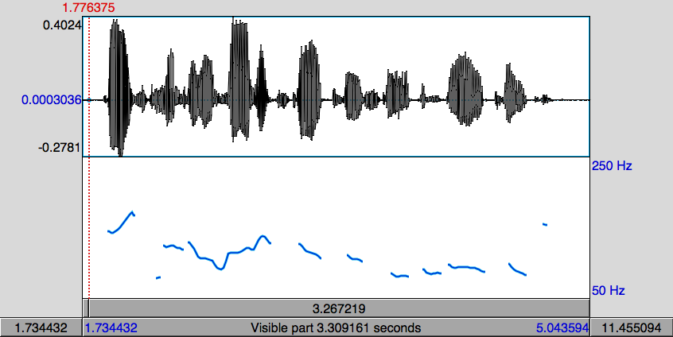
Pitch Contour Example
DoublingError
Halving Error
Pitch (fundamental frequency) is estimated by finding the length of the period of the speech signal.
If a cycle is missed, the period appears to be twice as long (pitch halving)
If an extra cycle is found, the period appears to be half as long (pitch doubling)

Slide 17
ToBI (Tones and Break Indices)
Based on Pierrehumbert’s “intonational phonology” Silverman et al. 1992
Prosody is described by high (H) and low (L) tones that are associated with prosodic events (pitch accents, phrase accents, and boundary tones) and break indices which describe the degree of disjuncture between words.
ToBI is inherently categorical in its description of prosody
ToBI variants exist for at least American English, German, Japanese, Korean, Portuguese, Greek, Catalan

Slide 18

ToBI Accenting
Words are labeled as containing a pitch accent or not.
There are five possible pitch accent types (in SAE).
High tones can be produced in a compressed pitch range – catathesis, or “downstepping”.
H*
L*
L*+H
L+H*
H+!H*
Notes:
Examples!!!!

Slide 19
ToBI Phrasing
ToBI describes phrasing as a hierarchy of two levels.
Intermediate phrases contain one or more words.
Intonational phrases contain one or more intermediate phrases.
Word boundaries are marked with a degree of disjuncture, or break index
Break indices range from 0-4
>3 intermediate phrase boundary
4 intonational phrase boundary.
Notes:
Examples!!!!

Slide 20
ToBI Phrase Ending Types
Intermediate Phrase boundaries have associated Phrase Accents describing the pitch movement from the last accent to the phrase boundary
Phrase Accents: H-, !H- or L-
Intonational phrase boundaries have Boundary Tones describing the pitch movement immediately before the boundary
Boundary Tones: H% or L%
L-L%
L-H%
H-H%
H-L%
!H-L%
Notes:
Examples!!!!

Slide 21
ToBI Example (in Praat)
Notes:
Include audio example

Slide 22
Fujisaki model
Superpositional view of intonation Fujisaki & Hirose 1982
Prosody is described by a phrase command which is modified by accent commands.
In the Fujisaki model, this is an additive process in log Hz space.

Slide 23
Fujisaki model

Slide 24
Superpositional vs. Sequential
Superpositional models require identification of a phrase signal.
Sequential models describe one prosodic event – phrasing or prominence – at a time.
Similarities
Both describe phrasing and accenting.
If the phrasal context can be accommodated by a sequential model, there are no analytical reasons to suspect that
Differences
Categorical vs. continuous accent types.
Superpositional model is tightly coupled with pitch.

Slide 25
Direct Modeling
Direct modeling takes a task-specific approach to prosodic analysis vs. identifying prosodic information irrespective of task. Shriberg & Stolcke 2004
Acoustic features are given “directly” to a classifier performing some spoken language processing task, e.g. sentence segmentation.
Discriminative qualities of the acoustic features to the task are then learned specific to the target class rather than as a general quality of the speech.
Acoustic Features
Task-Specific Classifier

Slide 26
Some Typical Acoustic/Prosodic Features
Features extracted from Acoustic Contours
Pitch
Intensity
Standard Aggregations
min, max, mean, st. dev.
Common Transformations
slope (𝚫), accelleration (𝚫𝚫)
Speaker normalization
Voicing information
Onset times, intervals
Duration and Silence

Slide 27
Some Typical Lexical Features
Lexical Identity – “AccentRatio” Nenkova et al. 2007
Function vs. Content Words Ross & Ostendorf 1996
Part of Speech Tags Ross & Ostendorf 1996
Syntactic Disjuncture Wang & Hirschberg 1991 Hirschberg & Rambow 2001
Position in Sentence Sun 2002, etc.
Number of syllables Sun 2002, etc.

Slide 28
Suprasegmental
Prosodic variation is a suprasegmental quality.
That is, the variation spans phone boundaries.
Often the variation spans multiple words, or sentences, relying on multi-word context.
Signal processing techniques for speech often operate using local information (10 ms frames).
f0 estimation, VAD, FFT, MFCC, PLP-RASTA, e.g.
less reflective of linguistic properties of speech
This forces prosodic analysis to use different techniques that are reflective of these domains.
Notes:
We will talk more about the role of context later.

Slide 29
Dimensions of Prosodic Variation
Pitch
“Intonation”
Hz, Log Hz (semitones), Mel, Bark.
Intensity
Duration
Spectral Features
MFCC
Spectral Tilt, Spectral Emphasis, Spectral Balance
Rhythm
Silence
Notes:
What else is there?

Slide 30
Pitch
Prosody is often implicitly taken to be primarily a function of pitch. Bolinger 1958, Terken & Hermes 2000, Beckman 1986, Ladd 1996
All descriptions of prosody rely on pitch – some exclusively.
Prosodic Event types are differentiated by pitch.
Question intonation is clearly indicated by pitch.
Contrast is indicated in part by timing of pitch peaks.
There is certainly more to prosody than only pitch, though it remains a significant dimension of prosodic variation

Slide 31
Pitch Units
Units of analysis: Hz, Log Hz (semitones), Mel, Bark.
Perception of pitch has a log linear relationship to frequency.
Doubling and Halving errors are relatively frequent in pitch estimation.
In a log linear domain, these errors have equal impact. In a linear domain, doubling errors are ~4x more damaging than halving errors.
Notes:
Perceptual and numerical reasons to be skeptical of f0 (Hz) as the best measure for prosodic analysis.

Slide 32
Intensity
There has been an increased consideration of intensity – ‘loudness’ – in prosodic analysis.
Relative intensity has been found to be at least as good a predictor of prominence as pitch. Kochanski et al. 2005, Silipo & Greenberg 2000, Rosenberg & Hirschberg 2006
Has the advantage of being extracted more reliably from the speech signal.
Requires normalization to account for recording conditions – microphone gain, proximity, etc.

Slide 33
Duration
There are durational correlates to both accenting and phrasing.
Prominent words are longer than deaccented words.
Prominent syllables are longer than deaccented syllables.
Phones that precede phrase boundaries are longer than phrase internal phones. (Pre-boundary lengthening.)
Notes:
Content words are accented with a greater frequency than function words. Content words have more syllables than function words. Thus accented words are longer.
One argument is that it takes time to generate the necessary acoustic excursion.

Slide 34
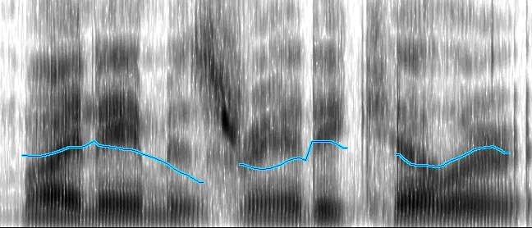
Spectral Qualities
Spectral Tilt, Spectral Balance, Spectral Emphasis, High-Frequency Emphasis.
Shown to correlate with prominence. Sluijter & Van Heuven 1996-7, Fant et al. 1997
Increased subglottal pressure leads to increased energy in higher frequencies of the spectrum.
MFCC/PLP features are able to capture this information implicitly.

Slide 35
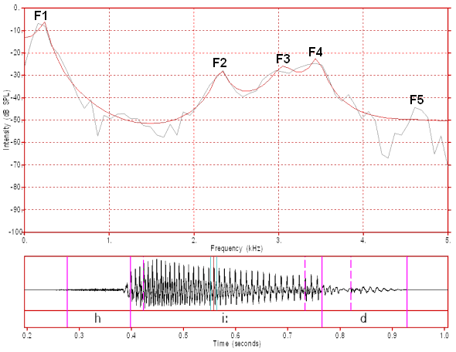
Spectral Balance/Tilt
Calculate a spectrogram
Spectral balance is calculated with respect to a specific Hz threshold, say 500Hz Sluijter & Van Heuven 1996,1997
Where the STFT is typically calculated with a 10ms frame and 25ms hamming window
Australian male /i:/ from “heed” FFT analysis window 12.8ms
http://clas.mq.edu.au/acoustics/speech_spectra/fft_lpc_settings.html

Slide 36
Spectral Tilt
Calculate a spectrogram
Spectral tilt is the slope of the least squares estimate the log spectrogram Fant et al. 1997, Campbell & Beckman 1997
Where the STFT is typically calculated with a 10ms frame and 25ms hamming window
Australian male /i:/ from “heed” FFT analysis window 12.8ms
http://clas.mq.edu.au/acoustics/speech_spectra/fft_lpc_settings.html
Notes:
OLS linear regression. It has a closed form. COV(x,y)/VAR(y)

Slide 37
Rhythm
In “stress-timed” languages, stressed syllables are approximately equally spaced.
However, the rhythm resets at phrase boundaries.
One difficulty in analyzing this is that intermediate phrases may be 3-4 words long providing very few samples to detect a consistent rhythm.
Promising area for future research.
Notes:
Ignoring the controversy surrounding whether this distinction has merit. Worth investigating in “syllable timed” languages as well.

Slide 38
Silence
Silence is a powerful indicator of phrasing.
Identifying silence is generally the easiest signal processing task.
Envelope threshholding is sufficient for relatively cleanly recorded speech.
Biggest problem is distinguishing stops (<50ms) from silence.

Slide 39
Outline
Preliminary Material [30]
Techniques for Prosodic Analysis [75]
Applications of Prosodic Analysis [45]
AuToBI for Prosodic Analysis [30]

Slide 40
Techniques for Prosodic Analysis
Symbolic vs. direct modeling
“Standard Approach” for symbolic prosodic analysis
Shape modeling for acoustic contours
Context and Regions of analysis
Ensemble Approaches
Semi-supervised Approaches

Slide 41
Symbolic vs. Direct Modeling
Symbolic
Acoustic Features
Prosodic Analysis
Task-Specific Classifier
Direct
Acoustic Features
Task-Specific Classifier
Symbolic Modeling
Modular
Linguistically Meaningful
Perceptually Salient
Dimensionality Reduction
Direct Modeling
Appropriate to the Task
Lower information loss
General
Notes:
This is an distinction point (2-3 minutes).

Slide 42
The Standard Corpus-Based Approach
Identify labeled training data
Decide what to label – syllables or words
Extract aggregate acoustic features based on the labeling region
Train a supervised classifier
Evaluate using cross-validation or a held-out test set.

Slide 43
The Standard Corpus-Based Approach
Identify labeled training data
Can we use unlabeled data?
Decide what to label – syllables or words
Extract aggregate acoustic features based on the labeling region
Train a supervised model
Evaluate using cross-validation or a held-out test set.

Slide 44
The Standard Corpus-Based Approach
Identify labeled training data
Decide what to label – syllables or words
Are these the only options? [Context and Region of analysis]
Extract aggregate acoustic features based on the labeling region
Train a supervised model
Evaluate using cross-validation or a held-out test set.

Slide 45
The Standard Corpus-Based Approach
Identify labeled training data
Decide what to label – syllables or words
Extract aggregate acoustic features based on the labeling region
There are always new features to explore [Shape Modeling]
Train a supervised model
Evaluate using cross-validation or a held-out test set.
Notes:
describe mean min max standard deviation. Slope, normalized contours.

Slide 46
The Standard Corpus-Based Approach
Identify labeled training data
Decide what to label – syllables or words
Extract aggregate acoustic features based on the labeling region
Train a supervised model
Unsupervised and Semi-supervised approaches
Structured ensembles of classifiers
Evaluate using cross-validation or a held-out test set.

Slide 47
The Standard Corpus-Based Approach
Identify labeled training data
Decide what to label – syllables or words
Extract aggregate acoustic features based on the labeling region
Train a supervised model
Evaluate using cross-validation or a held-out test set.
Is this a reasonable approximation of generalization performance?

Slide 48
Available ToBI Labeled Corpora
Boston University Radio News Corpus
Available from LDC
6 speakers (3M, 3F)
Professional News Readers (Broadcast News)
Reading the same news stories
Boston Directions Corpus
Read and Spontaneous Speech
4 non-professional speakers (3M, 1F)
Speakers perform a direction giving task (spontaneous)
~2 weeks later, speakers read a transcript of their speech with disfluencies removed.
Switchboard Corpus
Available from LDC
Spontaneous phone conversations
543 speakers
Subset annotated with ToBI labels

Slide 49
Evaluation of prosodic analysis
Extrinsic evaluation
Evaluate the merit of the prosodic analysis by downstream task performance.
Spoken Dialog System Task Completion
Parsing F-Measure
Word Error Rate
Intrinsic evaluation
Cross-validation or held-out test set.
Within Corpus biases
Where possible, cross-corpus evaluation should be performed.
Speakers
Genre
Broadcast News vs. Conversation
Domain
Labelers
Lexical Content
Boston University Radio News Corpus Problem

Slide 50
Shape Modeling – Feature Generation
TILT
Tonal Center of Gravity
Quantized Contour Modeling
Piecewise linear fit
Bezier Curve Fitting
Momel Stylization
Fujisaki model extraction
Pitch Normalization

Slide 51
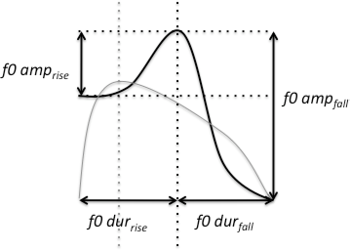
TILT
Shape Modeling
Describes an F0 excursion based as a single parameter Taylor 1998
Compact representation of an excursion

Slide 52
Tonal Center of Gravity
Shape Modeling
A measure of the distribution of the area under the F0 curve within a region.
Perceptually robust.
Better classification of pitch accent types than peak timing measures. Veilleux et al. 2009, Barnes et al. 2010

Slide 53
Quantized Contour Modeling
Shape Modeling
A Bayesian approach to simultaneously model contour shape and classify prosodic events Rosenberg 2010
Specify a number of time, M, and value, N, bins
Represent a contour as an M dimensional vector where each entry can take one of N values.
For extension to higher dimensions, allow values to be multidimensional vectors

Slide 54
Quantized Contour Modeling
Shape Modeling
Identify a region of analysis
Scale the time and value domain of the contour
Linear quantization in both dimensions
Train a multinomial classifier

Slide 55
Quantized Contour Modeling
Shape Modeling
72.91% accuracy on BURNC for ToBI phrase ending tones with sequential modeling of F0 and intensity
[+] Generative model allows model reuse for synthesis
[-] Quantization Error from scaling
Performance is dependent on the region of analysis

Slide 56
Pitch Contour regularization
Pitch estimation can contain errors
Halving, and doubling
Spurious pitch points
Smoothing out these outliers or unreliable points allows for more robust and reliable secondary features to be extracted from pitch contours.
Piecewise Linear Fit
Bezier Curve Fitting
Momel stylization

Slide 57
Piecewise Linear Fit
Shape Modeling
Make the assumption that a contour is made up of a number of linear segments.
Need to specify the number of segments.
Specify a minimum length of a region, maximum MSE, and search for optimal break point placement.
Ordinary Least Squares fit within regions
Shriberg et al. 2000

Slide 58
Bezier Curve Fitting
Shape Modeling
Bezier curves describe continuous piecewise polynomial functions based on control points.
An n-degree polynomial is described by interpolation of n+1 control points
Fitting Bezier curves to F0 contours provides smoother contours than piecewise linear fitting. Escudero et al. 2002
Control points are evenly spaced along an interval – e.g. intersilence regions.
Bezier Curves
Least Squares optimization

Slide 59
Momel Stylization
Shape Modeling
Momel (MOdélisation de MELodie): quadratic splines to approximate the “macroprosodic” component – intonation choices – as opposed to the “microprosody” of segmental choices Hirst & Espesser 1993
Omit points that are > 5% higher than neighbors
Within a 300ms analysis window centered at each x,
Perform quadratic regression
Omit points that are > 5% below the fit line
Repeat until no points are omitted
Identify a target point based on regression coefficients <t, h> where t = -b/2c and h = a +bt + ct²
Within a 200ms window centered at each x,
Identify “segments” by calculating d(x) based on the mean distances between the <t,h> values in the first and second half of the window.
Segment boundaries are set to points, x, s.t. d(x) is a local maximum and greater than the mean of all d(x)
Within each segment omit candidates where the average t or h values are more than one standard deviation of the mean within the segment.

Slide 60
Fujisaki model
Shape Modeling
The Fujisaki model can be viewed as a parametric description of a contour, designed specifically for prosody.
There are a number of techniques for estimating Fujisaki parameters – phrase and accent commands Pfitzinger et al. 2009

Slide 61
Estimating Fujisaki model parameters
Shape Modeling
Use MOMEL to smooth the pitch contour.
HFC – high pass filter @ 0.5Hz
LFC – every thing else
Local minima of LFC are phrase commands.
Local minima of HFC define boundaries of accent commands.
Mixdorff 2000

Slide 62
Pitch Normalization
Shape Modeling
Speakers have different pitch to their voice largely due to changes in vocal tract length.
To generate robust models of prosody, speaker differences need to be eliminated.
Z-score normalization is a common approach.
Distance from the mean in units of standard deviations
Can be calculated over each utterance or a whole speaker.
Monotonic – preserves extrema

Slide 63
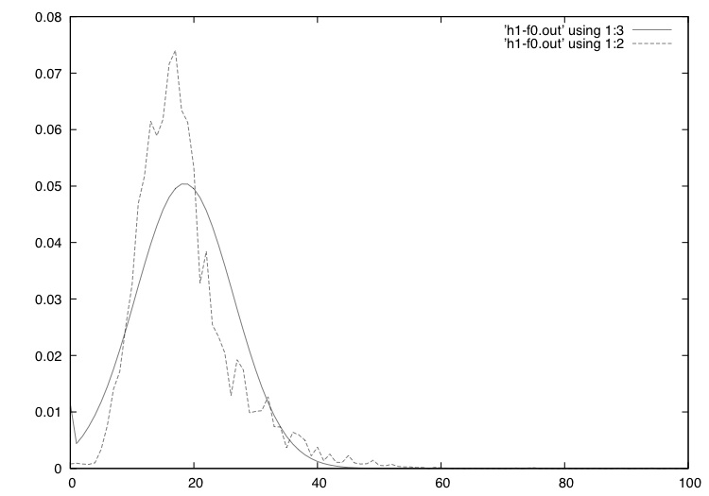
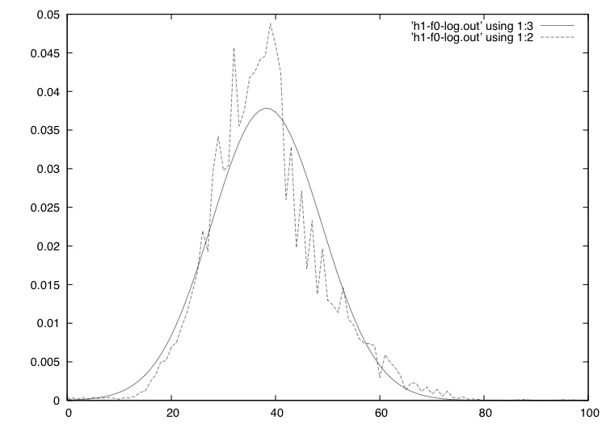
Pitch Normalization
Shape Modeling
Pitch is a perceptual quality in a log-linear relationship to fundamental frequency.
Z-score normalization implicitly assumes that the material is normally distributed.
In addition to perceptual considerations, log Hz is more normally distributed than Hz.
Hz
log Hz

Slide 64
Normalization of Phone Durations
Phones in stressed syllables have increased duration as do preboundary phones. Wightman et al. 1991
Duration is impacted by the inherent duration of a phone (Klatt 1975) as well as speaking rate and speaker idiosyncrasies.
Wightman et al. 1991 use z-score normalization using mean values calculated per speaker per phone.
Monkowski et al. 1995 note that phone durations are more log-normal than normally distributed, suggesting that z-score normalization of log durations is more appropriate

Slide 65
Analyzing Rhythm
Prosodic rhythm is difficult to analyze.
Measures have been used to classify languages as stress- or syllable-timed including nPVI, %V, ΔV, ΔC, but have received little attention in prosodic analysis. Grabe & Low 2002
%V – percentage of time taken up by vowels
ΔV – distance between vowels
ΔC – distance between consonants
nPVI – ratio of difference between consecutive durations to their average duration. using duration of vocalic or intervocalic regions.

Slide 66
Prosodic Rhythm
Brady 2010 examined prosodic temporal structure by measuring phase angles of an oscillator aligned with reference points – here Vowel Onsets – in speech.
Phase clustering is used to calculate R* the length of the sum of phase angle vectors.
Oscillator banks are used to identify the best fit within a prosodic phrase.
This is new research but provides a promising technique for prosodic analysis of rhythm.

Slide 67
Context identification
Context of analysis is important for prosodic analysis due to its suprasegmental nature.
Short time analysis
HMMs
The role of context in prosody
Words vs. Syllables vs. Vowels

Slide 68
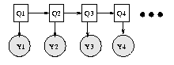
Short-Time prosodic analysis
Hidden Markov Models have proved to be powerful sequential models.
Chaolei et al. 2005 explored HMM modeling using MFCC features, energy and pitch at 10ms frames.
MFCC and energy predict at 70.5% accuracy, inclusion of pitch increases to 82% on BURNC.

Slide 69
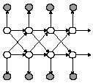
Short-Time prosodic analysis
Hidden Markov Models have proved to be powerful sequential models.
Ananthakrishnan & Narayanan 2005 explored the application of Coupled HMMs to prominence detection.
Acoustic information was extracted at 10ms frames – F0, intensity, current phone duration – with one stream per feature.
72.03% accuracy over 51.49% baseline.

Slide 70
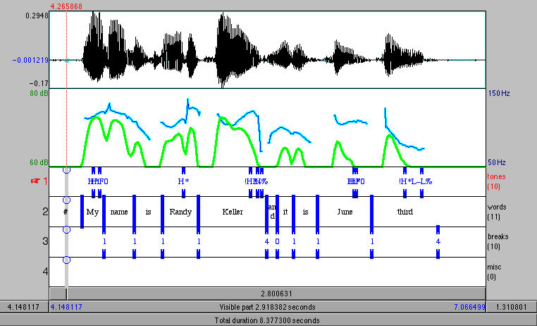
The role of context
Prominence is an acoustic quality of “standing out” from surroundings.
Detection of prominence is significantly improved through incorporation of acoustic context from preceding and following syllables. Levow 2005
Performance improves from 75.9% to 81.3% with slightly greater influence by the left context than the right.
Aside: Mandarin tone classification is also improved by the incorporation of acoustic context from 68.5% to 74.5%.

Slide 71
Words vs. Syllables vs. Vowels
In the detection of prominence, studies have examined prediction at word and syllable level.
Using a constant amount of context, word-based prediction is shown to be a better domain for detection. Rosenberg & Hirschberg 2009
This is due to the fact that acoustic excursions are not strictly constrained to syllable boundaries.
Analysis Region | Acc. context | Acc. no context
Vowel | 77.4 | 68.5
Syllable | 81.9 | 75.6
Word | 84.2 | 82.9

Slide 72
Ensemble techniques
Ensemble methods train a set, or ensemble, of independent models or classifiers and combine their results.
Examples
Boosting/Bagging
Classifier Fusion
Corrected Ensembles of Energy based classifiers
Ensemble sampling for imbalanced classes

Slide 73
Boosting/Bagging
Boosting trains one “weak” classifier for each feature, and learns weights to combine predictions.
The classifiers in adaboost are single branch decision trees
Boosting has been successfully applied to prominence detection with acoustic and lexical features by Sun 2002.
Prediction on a single speaker in BURNC, accuracy of 92.78%
Four-way accuracy High, Low, Downstepped, None = 87.17%

Slide 74
Classifier Fusion
So called “late-fusion” of classifiers.
Often used in direct modeling approaches, where a prosodic and lexical prediction are merged to make a decision. Shriberg & Stolcke 2004
Train models based on distinct feature sets, and merge their prediction by weighting confidence scores.

Slide 75
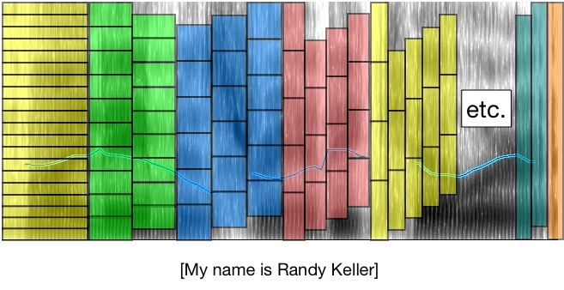
Corrected Ensembles of Classifiers
Examined the predictive power of 210 frequency regions varying baseline and bandwidth Rosenberg & Hirschberg 2006, 2007

Slide 76
Corrected Ensembles of Classifiers
There is significant differences in predictive power of frequency regions
99.9% of data points are correctly classified by at least one classifier
Weighted majority voting ~79.9% accuracy

Slide 77
Corrected Ensembles of Classifiers
Rather than use voting to combine predictions, use a second stage classifier
While this doesn’t lead to improvements, there were many subtrees where the classifier used acoustic context to indicate which ensemble member to trust

Slide 78
Corrected Ensembles of Classifiers
For each ensemble member, train an additional correcting classifier
Predict if an ensemble member will be correct or incorrect
Invert the prediction if the correcting classifier predicts incorrect

Slide 79
Correcting Classifier Diagram

Slide 80
Correcting Classifier Performance

Slide 81
Correcting Classifier Performance

Slide 82
Imbalanced Label Distributions
Often prosodic labels have very skewed distributions.
This is problematic for training classifiers.
Also makes accuracy an uninformative evaluation measure.
Classifiers tend to train better with relatively even class distributions.

Slide 83
Data Sampling techniques
Undersampling
Omit majority class instances, MA, s.t. the size of the majority class is equal to the minority class

Slide 84
Data Sampling techniques
Oversampling
Duplicate the minority class points, s.t. the number of minority and majority class points are equal

Slide 85
Data Sampling techniques
Ensemble Sampling Yan et al. 2003
Construct N undersampled partitions of the majority class.
Construct N even training sets using all of the minority classes, and one majority partition
Train N classifiers.
Merge predictions
A
A
B
A
C
A

Slide 86
Limited data approaches
There’s not all that much data available.
It’s resources intensive to annotate material.
Between 60x and 200x real time to perform full ToBI annotation. Syrdal et al. 2001
Semi-supervised techniques
Transfer/adaptation applications

Slide 87
Reciprosody
Developing shared repository for prosodically annotated material.
Free access for non-commercial research.
Actively seeking contributors.
http://speech.cs.qc.cuny.edu/Reciprosody.html

Slide 88
Co-Training
In co-training, two classifiers are trained on independent feature sets.
Both classifiers are used to predict labels on a set of unlabeled data.
High confidence (>0.9) predictions are added to the training set of the other classifier.
Repeat.
Jeon and Liu 2009 used Neural networks for Acoustic modeling and SVMs for syntactic modeling and trained with co-training on BURNC.
With relatively little training data (~20 utterances) performance can be significantly improved by using co-training

Slide 89
Cross-Genre training and domain adaptation
We saw earlier that performance can suffer when models trained on one speaking style (genre) are evaluated on another.
Margolis et al. 2010 found that combined training sets typically perform only slightly worse than in-genre training.
This paper also explores a number of unsupervised domain adaptation experiments but these were unsuccessful
Instance weighting weight source training points by similarity to target population.
Class Prior Adjustment adjust the class prior to match the target domain. Modest improvement with known target prior
Feature Normalization make source feature distributions match the target distribution by z-score normalizing based on target statistics

Slide 90
Summary of Techniques
Techniques to extract pitch features and representing contour shape
Handling imbalanced data
Classification techniques
Handling limited data.

Slide 91
Outline
Preliminary Material [30]
Techniques for Prosodic Analysis [75]
Ten Minute Break
Applications of Prosodic Analysis [45]
AuToBI for Prosodic Analysis [30]

Slide 92
Applications of Prosodic Analysis
Some major successes of prosodic analysis
Segmentation
Speech Summarization
Dialog Act Classification
Affect Classification
Prosodic Analysis in traditional NLP tasks
Part of Speech Tagging
Syntactic Parsing and Chunking
Prosody in Speech Recognition
Acoustic Modeling
Language Modeling
Prosody in Speech Synthesis
Lexical analysis to assign prosodic labels and f0 targets to synthesized material.

Slide 93
Direct vs. Symbolic Modeling
Two styles of incorporating prosodic information into spoken language processing applications.
Many successful applications use direct modeling.
Batliner et al. 2001 symbolic labels (e.g. ToBI) may not
Be reliably annotated or hypothesized
Capture the relevant prosodic information for a task
Symbolic
Acoustic Features
Prosodic Analysis
Task-Specific Classifier
Direct
Acoustic Features
Task-Specific Classifier

Slide 94
Segmentation
Sentence segmentation
Discourse structure
Identifying Candidates
Topic/story segmentation
Speech summarization

Slide 95
Sentence Segmentation
Sentences are syntactically defined.
SU “Sentence-like units” may be a sentence, phrase or word that express a single idea or thought
Can be reliably detected with language modeling and lexical features only.
Direct modeling of prosody has consistently been shown to improve segmentation performance
Kolar et al. 2006 – 23% (ref) and 26% (asr) reduction of error through incorporation of prosody (most gains from silence) – feature extension
Liu et al. 2004, Liu & Fung 2005 – 26% (ref) and 16% (asr) reduction of error - confidence of hyp prosodic phrasing
Huang et al. 2006 – 26% reduction of error – late fusion of LM and direct modeled prosody model.

Slide 96
Discourse Structure
There is evidence that at the start of a discourse segment speakers speak louder, faster, and with an expanded pitch range. [Hirschberg 1986]
Pauses are longer before new discourse topics. Pitch reset and Boundary tone contribute. Swerts 1997
There are not many corpora that are annotated for “discourse structure”.
VERBMOBIL, subset of Boston Directions Corpus, HCRC Map Task.
Related to “paragraph intonation”, shown to be able to more accurately predict F0 by taking paragraph structure into account. Tseng 2010
Important for natural speech synthesis.

Slide 97
Identifying Candidates
Topic Segmentation Rosenberg & Hirschberg 2007
Goal: Identify semantically coherent regions of speech
Performed on BN in English, Arabic and Mandarin as part of DARPA GALE
Identify Candidate Boundaries
Words, Sentences, Pauses, Intonational Phrases
Extractive Speech Summarization Maskey et al. 2008
Goal: Identify “relevant” regions of speech.
Identify candidate regions
Sentences, Pauses, Intonational Phrases

Slide 98
Identifying Candidates - Results
Topic Segmentation Rosenberg & Hirschberg 2007
Extractive Speech Summarization Maskey et al. 2008
Segmentation | English | Arabic | Mandarin
Word | .300 | .308 | .320
Sentence | .357 | .361 | .278
Pause (250ms) | .298 | .312 | .248
Hyp IPs | .340 | .333 | .266

Slide 99
Dialog act classification
Liscombe et al. 2006 classified question bearing turns in tutoring material
Prosodic information (74.5%) is more useful than lexical content (67.2%) though both help (79.7%)
Find that the most useful prosodic information is drawn from the final 200ms of a phrase. Also the best region of analysis for boundary tone classification.
Laskowski & Shriberg 2010 examined the relative impact of prosody and dialog contextual acoustic features to dialog act classification.
Both feature sets contribute in identifying all dialog behavior
Prosody dominant: floor holding, providing feedback (backchanneling, acknowledgement)
Context dominant: floor grabbing, turn ending behavior, etc.

Slide 100
Dialog act classification
Classifying 13 speech acts including query, acknowledgement, clarification, instruction explanation
Prosody improves performance by 8.33% over lexical features. Hoque et al. 2007
Direct modeling
Black et al. 2010 Classified couples speech in counseling by their dialog actions including accusation, and blame
Using only acoustic/prosodic features were able to classify at ~70% accuracy over 50% baseline.

Slide 101
Affect Classification
Direct modeling of prosody has been used extensively in the recognition of emotion in speech
Upshot:
Activation is signaled by speaking rate and dynamics.
Hot anger/Happiness vs. Sadness
Valence is difficult to recognize.
Hot anger vs. Happiness
Interspeech 2009 Emotion Challenge
FAU Aibo Emotion Corpus. Spontaneous. “emotionally colored”
Many participants used MFCC features as well as more typical prosodic markers.
Winner found that both short term MFCC/GMM features and long-range pitch features to improve the (then) state-of-the art on German speech Dumouchel et al. 2009, Kockmann et al. 2009
Notes:
these challenges use openSMILE as default feature extractor

Slide 102
openSMILE
Open source audio feature extraction toolkit Eyben et al. 2010
Generates Low Level Descriptors (LLDs) manipulated by Functionals http://sourceforge.net/projects/opensmile/
LLDs
Functionals

Slide 103
Traditional NLP Tasks
Tasks that have been successfully addressed in text.
Part of Speech Tagging
Syntactic Parsing and chunking.
Standard approach: retrain models on transcribed speech.
By ignoring prosody this approach treats speech as an error-ful genre of text.
There is research shows that prosodic analysis can contribute.

Slide 104
Part of Speech Tagging
Automatically hypothesized break indices can be used to improve part-of-speech CRF tagging Eidelman et al. 2010
Rescoring based on HMM modeling with latent annotations also show improvements.
In both experiments, oracle break indices show greater performance gains. This information is more valuable than automatic sentence segmentation.
However >90% of words are not ambiguous Charniak 1997

Slide 105
Syntactic Parsing
There is a lot of other work looking at the relationship between prosody and syntax.
Short story: Prosodic structure is not in direct correspondence with syntactic structure. However, the two are not independent.
Dreyer & Shafran 2007 explored ways to integrate prosodic markers into PCFG parsing.
Where b is a break index and a is a latent variable corresponding to the break index of the right most terminal of the non-terminal.
F-measure of 76.68 vs. 71.67 on Switchboard.
Huang & Harper 2010 extend this investigation finding similar improvements on Fisher corpus
Improvements are limited when a PCFG-LA model is used, but recovered when the prosodic annotations are used in rescoring initial PCFG-LA hypotheses.

Slide 106
Syntactic Chunking
Hypothesis: language learners (<1 year old) use prosodic cues to chunk language into units.
Pate & Goldwater 2011 examined this by looking for prosodic cues to prosodic chunking.
Use a Coupled HMM to simultaneously model words and prosody (directly and break indices)
Direct modeling based on durational cues (including vowel timing – onset/offset/proportion) is more reliable than manual break indices.

Slide 107
Prosody in Speech Recognition
Speech
Acoustic Model
Prosodic analysis
Pronunciation Model
Language Model
Words
Prosodic variation impacts spectral realization of a phone [Acoustic Modeling]
Words are not equally likely to be prominent, or precede or follow prosodic boundaries. [Language Modeling]
ASR performance improvements shown by groups at UIUC and SRI

Slide 108
Acoustic Modeling
Prosodic information impacts articulation and therefore spectral realization (MFCC)
Final vowels and initial consonants are less reduced around boundarues Fougeron & Keating 1997
Accented vowels are less affected by coarticulation Cho 2002
Manually labeled prosodic information is more helpful for acoustic modeling than phonetic context (triphone) Borys et al. 2004
Allophone recognition correctness improves from 14.32% to 34.76% on BURNC Chen et al. 2006
0.8% reduction of WER Hasegawa-Johnson et al. 2004

Slide 109
Language Modeling
Modeling a sequence of prosodic events along with the sequence of words results in reduced Language model perplexity
Two approaches.
SRI – Prosodic events as a latent variable
UIUC – Explicit Prosody dependent bigram modeling
2-3% reduction of WER on Switchboard [Shriberg 2002, Hasegawa-Johnson et al. 2004
Event–Word Model
Prosodic Event Model
Pause Model
Duration Model
Traditional AM

Slide 110
Outline
Preliminary Material [30]
Techniques for Prosodic Analysis [75]
Applications of Prosodic Analysis [45]
AuToBI for Prosodic Analysis [30]

Slide 111
AuToBI
Automatic hypothesis of ToBI labels. Rosenberg 2010
Integrated feature extraction and classification
Takes many of the results and findings we’ve explored here, and folds them into an open source package.
AuToBI site: http://eniac.cs.qc.cuny.edu/andrew/autobi/

Slide 112
AuToBI User Perspective
Input:
Word boundaries
TextGrid, CPROM, BURNC forced alignment (.ala), flat text
Wav file
Trained models (available from AuToBI website)
Output:
Hypothesized ToBI tones (with confidence scores)
Praat TextGrid format

Slide 113
AuToBI Command Line Example
java –jar AuToBI.jar \
-text_grid_file=in.TextGrid \
-wav_file=in.wav \
-out_file=out.TextGrid \
-pitch_accent_detector=accent.model \
-pitch_accent_classifier=pa_type.model \
-intonational_phrase_detector=ip.model \
-intermediate_phrase_detector=interp.model \
-phrase_accent_classifier=phraseac.model \
-boundary_tone_classifier=bt.model
Notes:
TODO fix command line example

Slide 114
AuToBI Schematic
Audio (wav)
Normalization Parameters
Segmentation (TextGrid)
ToBI Annotation Specific Feature Extraction
ToBI Annotation Specific Classifier
Hypothesized Prosodic Events
Evaluation

Slide 115
AuToBI Performance
Cross-Corpus Performance: BURNC → CGC
Available models
Boston Directions Corpus
Read, Spontaneous, Combined
Boston Radio News Corpus
Developing models for French, Italian, European and Brazillian Portuguese
Task | Accuracy
Pitch Accent Detection | 73.5%
Pitch Accent Classification | 69.78%
Intonational Phrase Boundary Detection | 90.8% (0.812 F1)
Phrase Accents/Boundary Tones | 35.34%
Intermediate Phrase Boundary Detection | 86.33% (0.181 F1)
Phrase Accents | 62.21%

Slide 116
Region Object
High level abstraction of a time defined region.
Can hang arbitrary “attributes” off of it.
public class Region implements Serializable {
private static final long serialVersionUID = 6410344724558496468L;
private double start; // the start time
private double end; // the end time
private String label; // an optional label for the region.
// For words, this is typically the
// orthography of the word
private String file; // an optional field to store the path to the
// source file for the region.
private Map<String, Object> attributes; // a collection of
// attributes associated
// with the region.
}

Slide 117
Feature Extraction
FeatureExtractor objects are registered with AuToBI.
These describe which features they extract and which they depend on.
FeatureSet objects describe the requested features for a classification task.
AuToBI only extracts necessary features.

Slide 118
Feature Registry
PitchFE Requires:
Generates: “f0”
Feature Registry
FE | Feature Name
 | f0
 | logf0
 | norm_logf0
 | norm_logf0_mean
 | norm_logf0_max
 | norm_logf0_min
LogContourFE Requires: “f0”
Generates: “logf0”
NormalizedContourFE Requires: “logf0”
Generates: “norm_logf0”
ContourFE Requires: “norm_logf0”
Generates: “norm_logf0_mean” “norm_logf0_max” “norm_logf0_min”

Slide 119
Feature Dependency
F0
Intensity
Spectrum
Log F0
Feature Set
Normalized
Log F0
Mean norm log f0 contextA
Mean norm log f0 contextB
Mean norm log f0 contextC
Context Window A
Context Window B
Context Window C
Mean
Mean
Mean

Slide 120
Classifier Interface
Built-in weka integration
Any classifier available in weka can be used with a one-line change to AuToBI’s internals.
Preliminary integration of liblinear
AuToBIClassifier classifier = new WekaClassifier(new Logistic());
classifier.train(feature_set);
AuToBIClassifier classifier = new WekaClassifier(new SMO());
classifier.train(feature_set);

Slide 121
AuToBI as an API
Using different Features:
Modify the required_features list on a FeatureSet
public class PitchAccentClassificationFeatureSet extends FeatureSet {
/**
* Constructs a new PitchAccentClassificationFeatureSet.
*/
public PitchAccentClassificationFeatureSet() {
super();
required_features.add("duration__duration");
for (String acoustic : new String[]{"f0", "I"}) {
for (String norm : new String[]{"", "norm_"}) {
for (String slope : new String[]{"", "delta_"}) {
for (String agg : new String[]{"max", "mean", "stdev", "zMax"}) {
required_features.add(slope + norm + acoustic + "_pseudosyllable" + "__" + agg);
}
}
}
}
class_attribute = "nominal_PitchAccentType";
}
}

Slide 122
AuToBI as an API
Extending AuToBI with other feature extractors
public abstract class FeatureExtractor {
protected List<String> extracted_features;
protected Set<String> required_features;
/**
* Extracts the registered features for each region.
*/
public abstract void extractFeatures(List regions)
throws FeatureExtractorException;
}
AuToBI autobi = new AuToBI();
autobi.registerFeatureExtractor(new MyFeatureExtractor());

Slide 123
AuToBI as an API
Extending AuToBI with other classifiers
public abstract class AuToBIClassifier implements Serializable {
/**
* Return the normalized posterior distribution from the classifier.
*/
public abstract Distribution distributionForInstance(Word testing_point) throws Exception;
/**
* Train the classifier on the given FeatureSet
*/
public abstract void train(FeatureSet feature_set) throws Exception;
/**
* Construct and return an untrained copy of the classifier.
*/
public abstract AuToBIClassifier newInstance();
}

Slide 124
AuToBI as an API
Including AuToBI in a broader SLP pipe
The AuToBI Region object is extensible, serializable and very flexible.
Can easily represent speaker turns, utterances, sentences, etc.
Sacrifices flexibility for efficiency
Each attribute is a key-value pair.

Slide 125
AuToBI as a Web Service
http://speech.cs.qc.cuny.edu:8080/AuToBIService/
Very early tool
Upload a TextGrid file and matching wav file
Words must be marked in an interval tier named “words”
Select a set of AuToBI Models
Generate predictions
Next Steps:
User sessions
Download of extracted features

Slide 126
AuToBI Limitations
Inefficiencies
needs >1G ram to run on ~5min files.
Not yet fast enough to be used in real-time analysis.
Each of the classification tasks are independent
Files might not end at a phrase boundary
Phrases may not contain any accented words
Does not predict disfluencies

Slide 127
Next Features in AuToBI
Efficiency Improvements
Guarantees of generating valid ToBI sequences.
Prediction without initial word segmentation.
Extension to languages other than English
Feature Requests are very welcome.

Slide 128
Outline
Preliminary Material [30]
Techniques for Prosodic Analysis [75]
Applications of Prosodic Analysis [45]
AuToBI for Prosodic Analysis [30]

Slide 129
In Conclusion
Prosodic Analysis Techniques
Direct vs. Symbolic Modeling
Acoustic Contour Modeling
Ensemble Techniques
Dealing with limited Data
Prosodic Analysis Applications
Paralinguistic and Discourse Tasks
Segmentation
Core NLP Tasks
Speech Recognition
Tools and Resources
AuToBI
openSMILE
Reciprosody

Slide 130
Future of Prosody Research
Robust representations of prosody
Expansion of Languages for which prosodic analysis is possible
Speech to speech translation
Language Identification
Deeper and earlier integration into spoken language processing
Deeper: more available information “rich transcription” for spoken language processing
Earlier: Incorporation into speech recognition, parsing, language modeling

Slide 131
References (1/3)

Slide 132
References (2/3)

Slide 133
References (3/3)

